Slide 1

Design Thinking

Slide 2
Apa itu design thinking
dan
kenapa sangat populer?

Slide 3
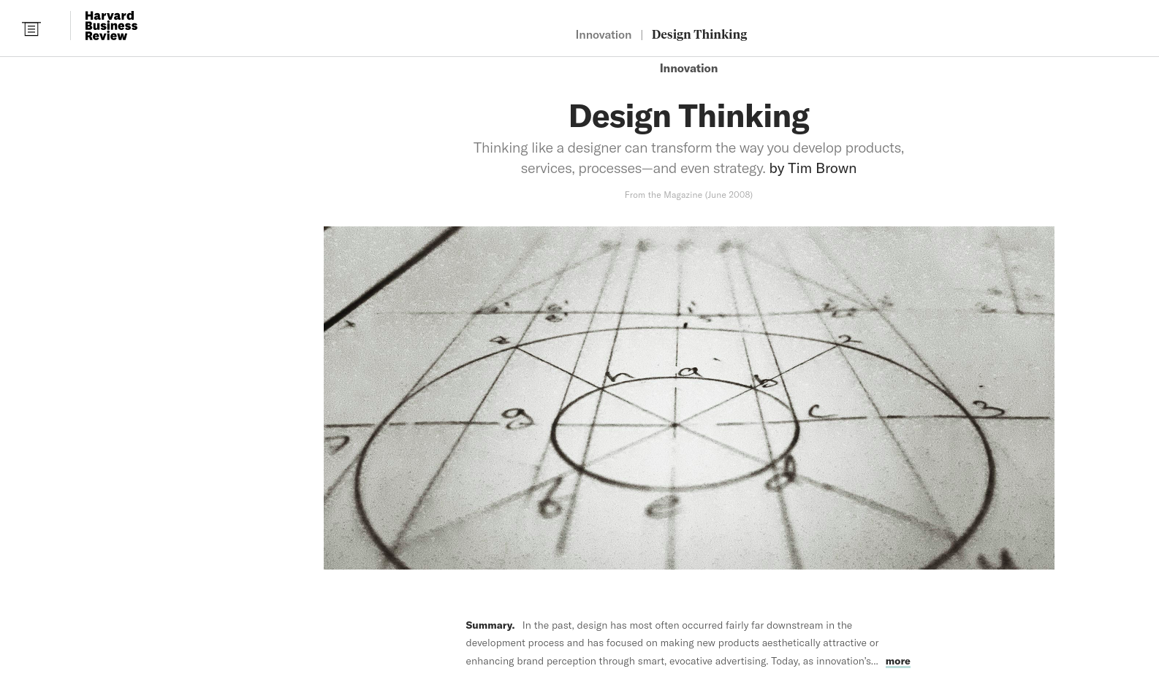

Slide 4
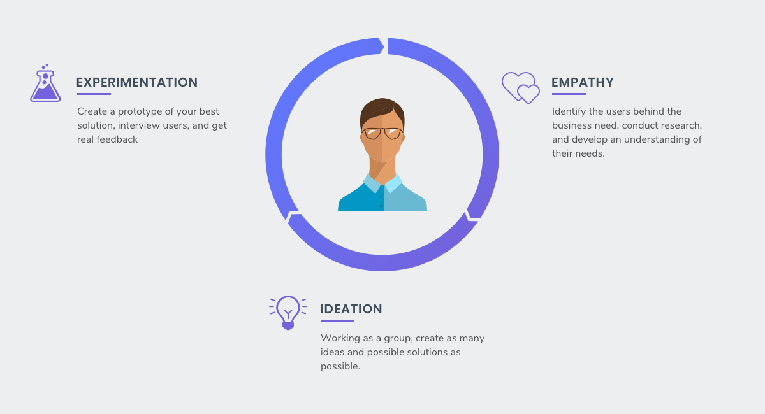

Slide 5
DESIRABLE
(meet customer needs)
“Put simply, (design thinking) is
an approach to innovation that
uses designer’s sensibility
and methods to match people’s needs
with what is technologically feasible
and what a viable business strategy
can convert into customer value
and business opportunity.”
- Tim Brown, CEO of IDEO
FEASIBLE
(technology)
VIABLE
(business
opportunity)
Where design
Thinking lives

Slide 6

3E PRINCIPLES OF DESIGN THINKING
Ensure
Innovation is
Customer
centered
Ensure wide
Variety of
Solutions have
Been explored
Ensure
Innovation is
evidence-based

Slide 7
Asal usul dan perkembangan design thinking

Slide 8
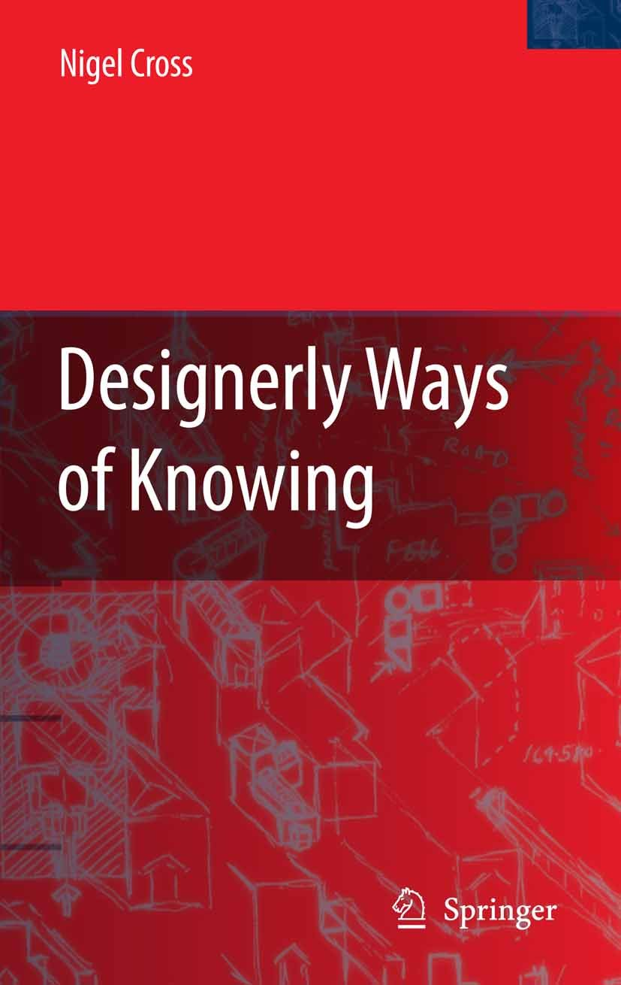
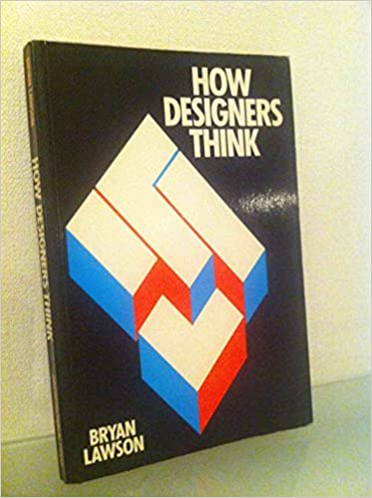
HISTORY OF DESIGN THINKING: 1980s
Designerly Ways of Knowing
Nigel Cross (1982)
How Designers Think
Bryan Lawson (1980)

Slide 9
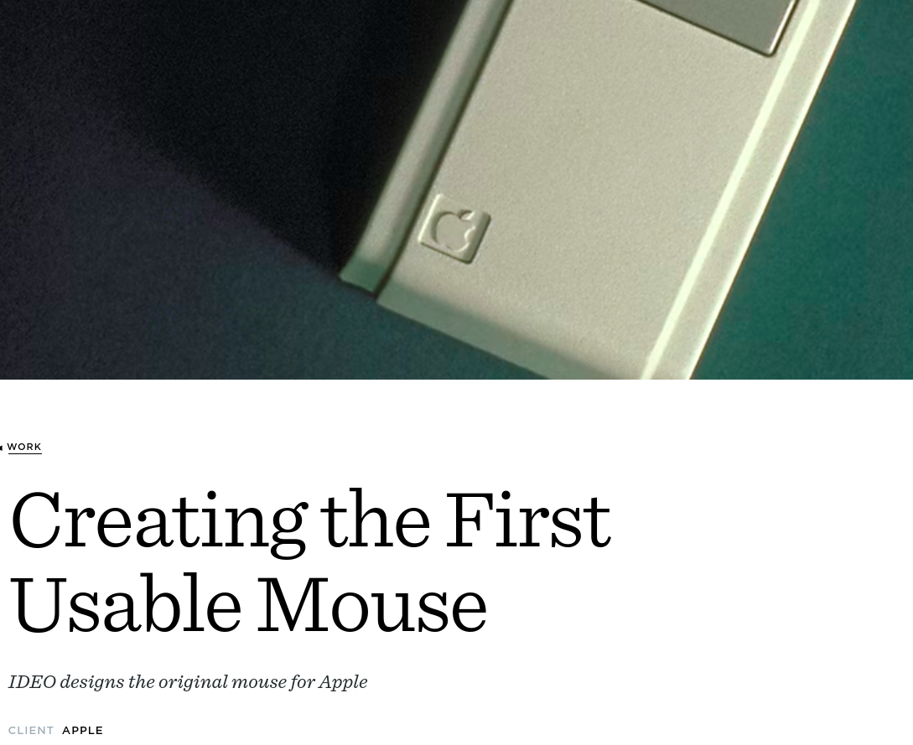
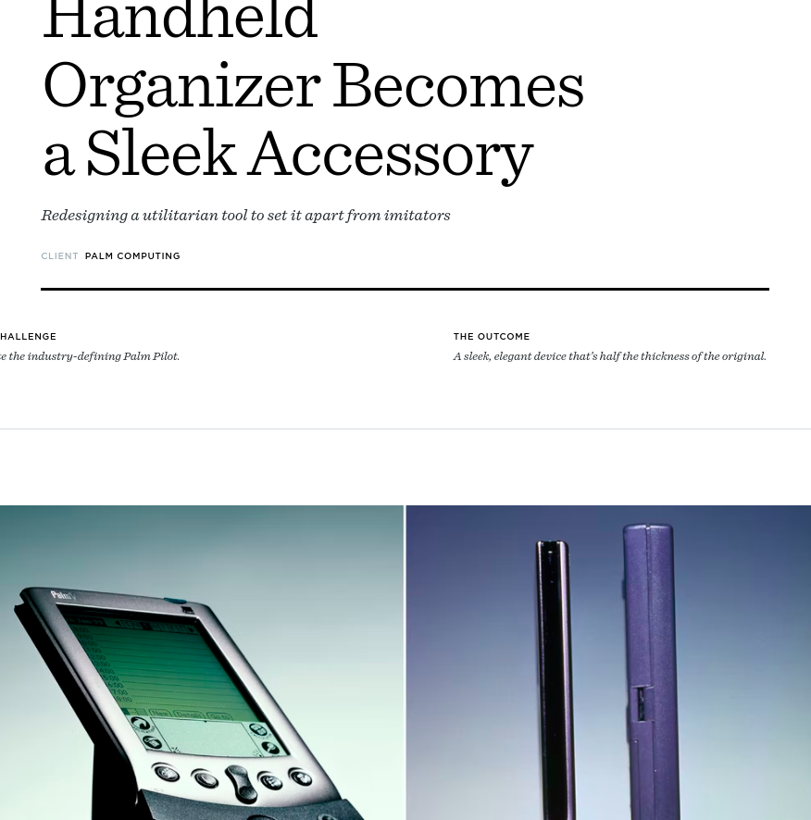
HISTORY OF DESIGN THINKING: 1990s
IDEO
DESIGN THE FIRST COMMERCIALLY
MANUFACTURABLE COMPUTER MOUSE
APPLE
MOVE THE PDA FROM EARLY
ADOPTION TO ESSENTIAL
PROFESSIONAL TOOL
PALM COMPUTER

Slide 10
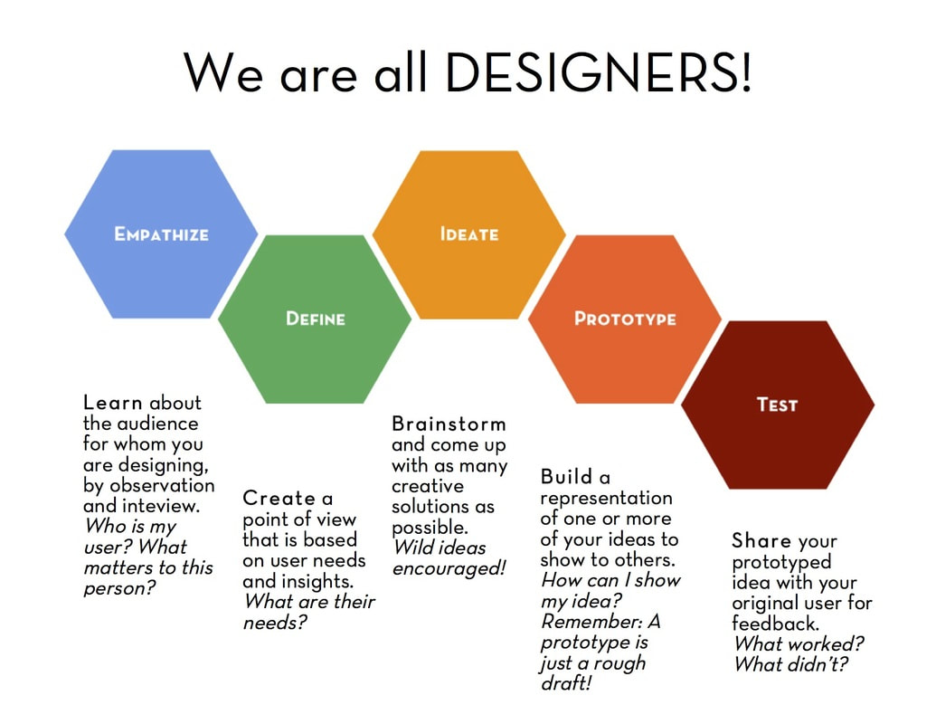
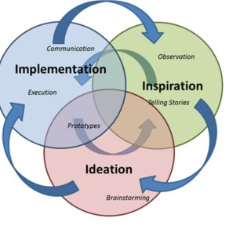
HISTORY OF DESIGN THINKING: 2000s
IDEO Design Thinking Process
Standford d.school Design Thinking Process

Slide 11
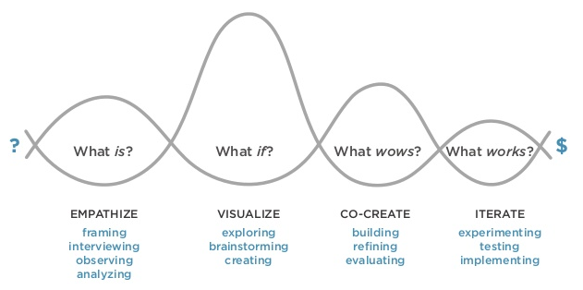
HISTORY OF DESIGN THINKING: 2010s
Professor Jeanne Liedtka’s Design Thinking Process

Slide 12
5 Tahapan Design Thinking

Slide 13
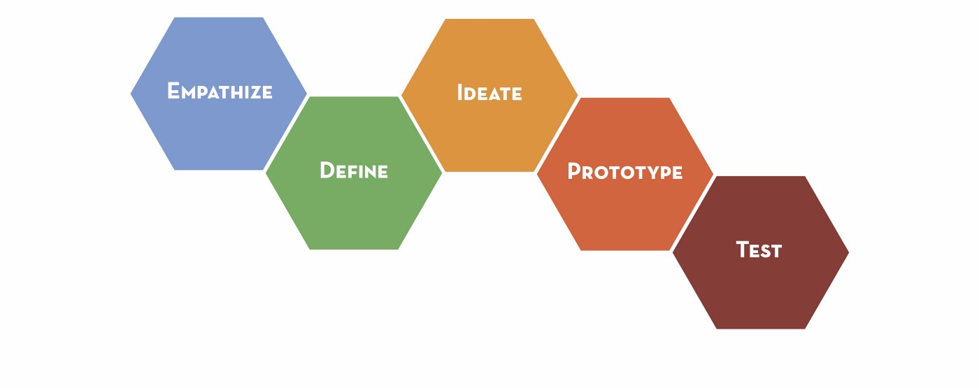
THE 5 STEPS OF DESIGN THINKING
(standford d.school Design Thinking Process)
Menguji coba kan prototype dengan customer untuk mendapatkan umpan balik terkait solusi yang dibuat
Memahami perspektif dan perasaan dialami customer (keluhan, keinginan)
Menghasilkan ide-ide solusi sebanyak dan sekreatif mungkin; dan memilih ide solusi terbaik
Mendefinisikan permasalahan customer yang akan diselesaikan dari sudut pandang customer
Membuat prototype atau representatif solusi yang konkrit dan bisa diindra

Slide 14
DESIGN THINKING ITERATIONS

Slide 15
Kenapa butuh design thinking untuk berinovasi?

Slide 16
SEMAKIN KESINI, KEUNGGULAN KOMPETITIF YANG DIMILIKI PERUSAHAAN SEMAKIN PENDEK MASA GUNANYA.

Slide 17


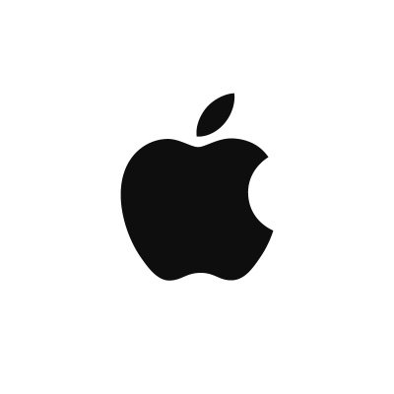




Slide 18
COMPETITOR
FOCUSED
TECHNOLOGY
FOCUSED
Mengeluarkan inovasi
Secepat pesaing
Mengeluarkan inovasi
Dengan teknologi paling
mutakhir

Slide 19

Design Thinking
Fokus menggali keinginan dan kebutuhan customer yang belum diketahui

Slide 20
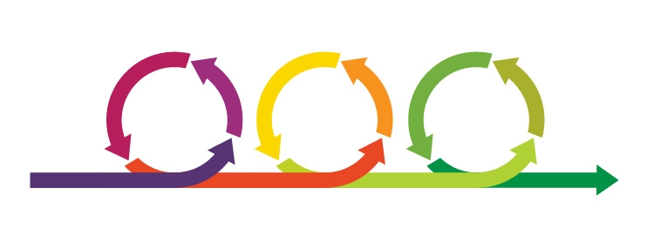
Design Thinking
Mengembangkan solusi secara iterative dan eksperimentatif

Slide 21
Keuntungan menggunakan design thinking

Slide 22
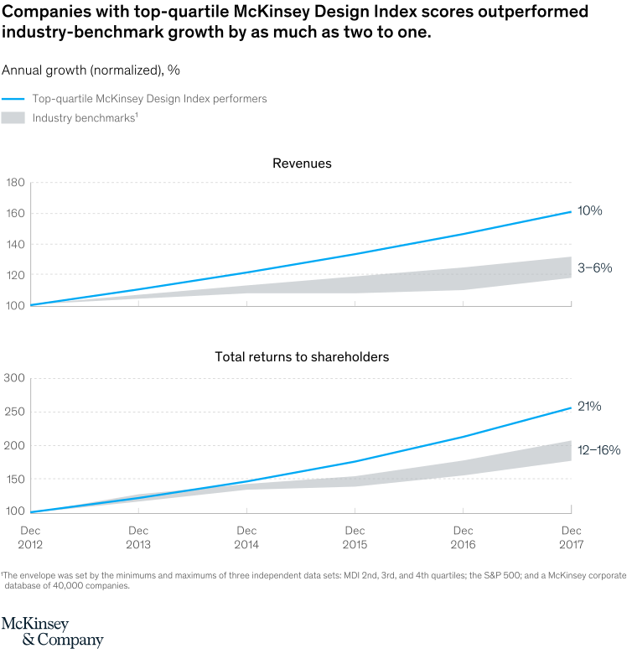
(Penghasilan)
Pertumbuhan Tahunan
(Dividen pemegang saham)
Perusahaan yang intensif menerapkan Design Thinking
Rata-rata industri

Slide 23
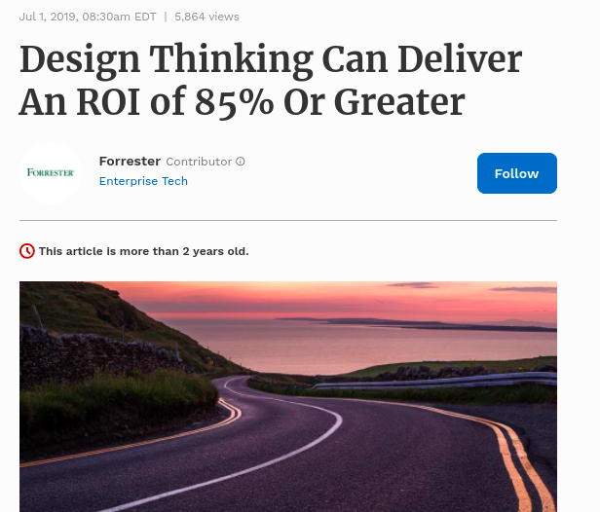
Examined at an organizational level, a mature design thinking practice can achieve an ROI between 71% and 107%, based on a consistent series of inputs and outputs.

Slide 24
INVESTASI DALAM DESIGN THINKING
Dalam Design Thinking, setiap iterasi menghasilkan pembelajaran baru yang menurunkan risiko/ketidakpastian, sehingga investasi dilakukan secara gradual per iterasi.
INVESTASI
RISIKO/KETIDAKPASTIAN
JUMLAH ITERASI

